Slide 1
ANN for Concrete Strength prediction

Slide 2
Different Algorithms as optimizers
Activation function: sigmoid
Loss function: MSE
Algorithms | r-squared | std. of r^2 | mse | std. of mse
adadelta | -0.1825 | 0.8841 | 59.66 | 43.94
adagrad | 0.5627 | 0.0154 | 22.17 | 0.77
adam | 0.5986 | 0.0113 | 20.35 | 0.6
nadam | 0.6035 | 0.0113 | 20.1 | 0.54
rmsprop | 0.5987 | 0.0204 | 20.34 | 0.94
sgd | 0.5837 | 0.0119 | 21.11 | 0.64

Slide 3
Different Activation Functions
Algorithm: ADAM
Loss function: MSE
Activation function | r-squared | std. of r^2 | mse | Std. of mse
elu | 0.6119 | 0.0122 | 19.67 | 0.53
selu | 0.6128 | 0.0111 | 19.62 | 0.51
relu | 0.6191 | 0.0118 | 19.31 | 0.54
hard sigmoid | 0.5831 | 0.0104 | 21.13 | 0.54
sigmoid | 0.5999 | 0.0147 | 20.28 | 0.68
linear | 0.5146 | 0.0144 | 24.6 | 0.65
softmax | 0.5969 | 0.0132 | 20.44 | 0.75
softplus | 0.6023 | 0.0137 | 20.16 | 0.67
softsign | 0.6195 | 0.0149 | 19.28 | 0.7
hyperbolic tangent | 0.6231 | 0.0089 | 19.11 | 0.42
Notes:
Try different activation function

Slide 4
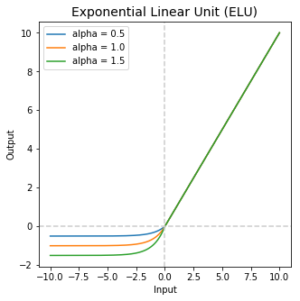
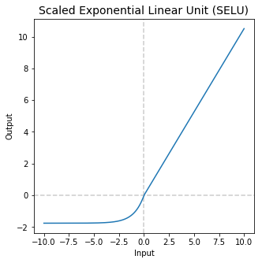
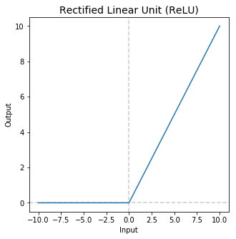

Slide 5
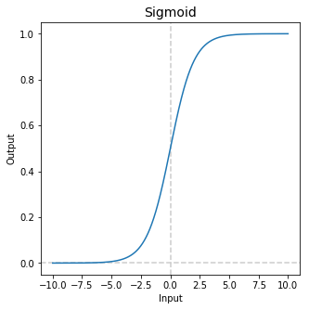

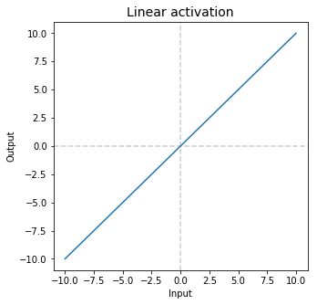

Slide 6
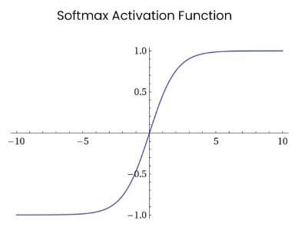
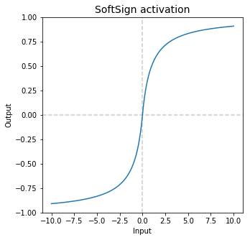
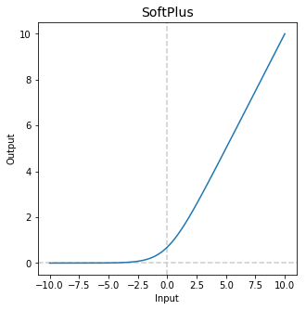
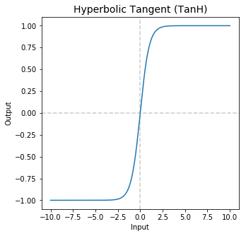

Slide 7
Levenberg - Marquardt Algorithm
J : Jacobian matrix
δ: 𝝎(i+1) - 𝝎(i)
ƛ: dumping factor
Gauss-Newton Algorithm
Steepest descent

Slide 8
Different Loss Functions
Algorithm: ADAM
Activation function: sigmoid
Loss function | r-squared | Std. of r^2 | mse | Std. of mse
MAPE | 0.0359 | 0.02 | 48.87 | 1.28
MAE | 0.5905 | 0.0136 | 20.76 | 0.66
MSLE | 0.1006 | 0.7094 | 45.35 | 35.19
MSE | 0.5999 | 0.0147 | 20.28 | 0.68
Notes:
Try different activation function

Slide 9
ANN model for concrete strength prediction
Input
Output
Number of Layers: 4
Number of neurons on each layer : 32
Activation Function : hyperbolic tangent

Slide 10
Gradually Increasing Ratio of Training Set
Keeping 20% of entire dataset as testing set
Gradually increasing ratio of training set from 4%to 80% of entire dataset
Testing set |  | Training set
20%
4% - 80%

Slide 11
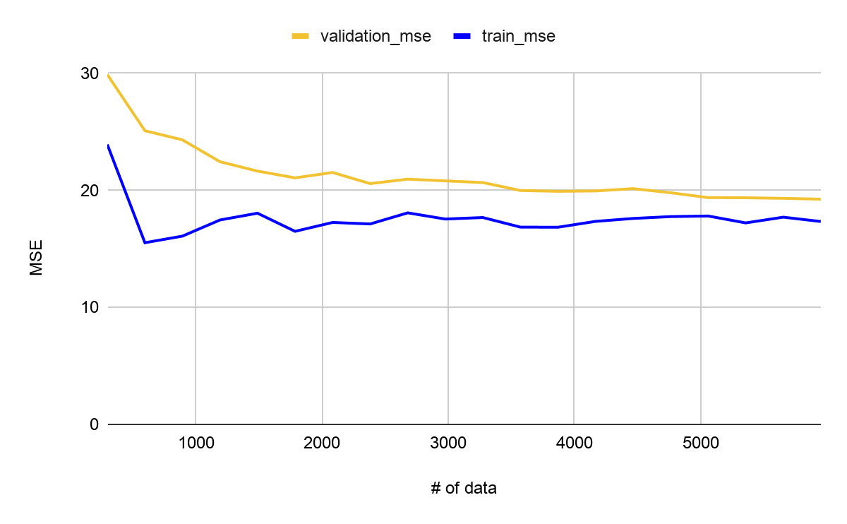
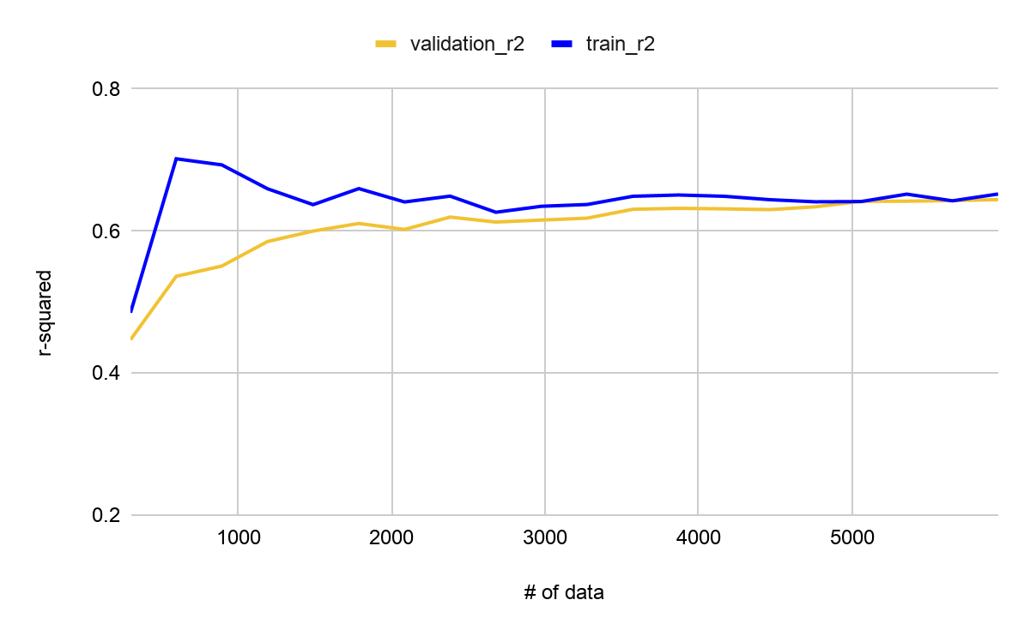
Gradually Increasing Ratio of Training Set

